Slide 1
SPACEX EDA - IBM APPLIED DATA SCIENCE CAPSTONE
BY VADHNA SAMEDY HUN

Slide 2
OUTLINE
. EXECUTIVE SUMMARY
. INTRODUCTION
. METHODOLOGY
. RESULTS
. CONCLUSION
. APPENDIX AND REFERENCES

Slide 3
EXECUTIVE SUMMARY
Summary of methodologies:
Data collection
Data wrangling
EDA with data visualization
EDA with SQL
Building interactive map with FOLIUM
Building a Dashboard with Plotly
Predictive machine learning
Summary of all results:
EDA results
Interactive analysis
Predictive analysis

Slide 4
INTRODUCTION
Project background and context
SpaceX’s Falcon 9 rocket launches with a cost of 62 million dollars; reusability is needed.
Problems I want to find answers:
This project is aimed to check whether the first stage of a SpaceX rocket will land successfully

Slide 5
METHODOLOGY
DATA collection:
SpaceX REST API
Web scraping (BeautifulSoup)
DATA wrangling:
One-hot encoding (get dummies)
EDA:
Using SQL and data visualization tools
Interactive visual analytics:
Folium and Plotly
Predictive analysis:
Machine learning methods

Slide 6
DATA COLLECTION
SpaceX data is gathered from the SpaceX REST API
Another method used is web scraping from Wikipedia using BeautifulSoup

Slide 7
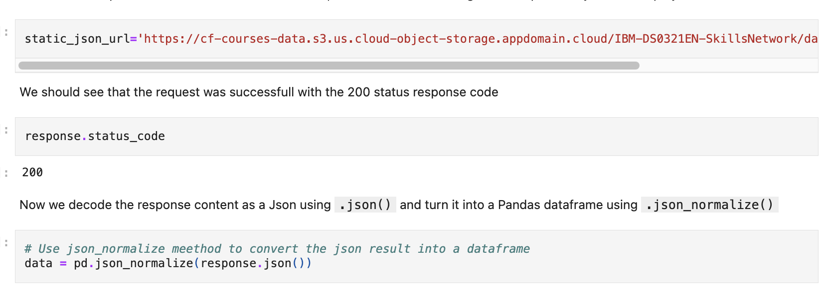
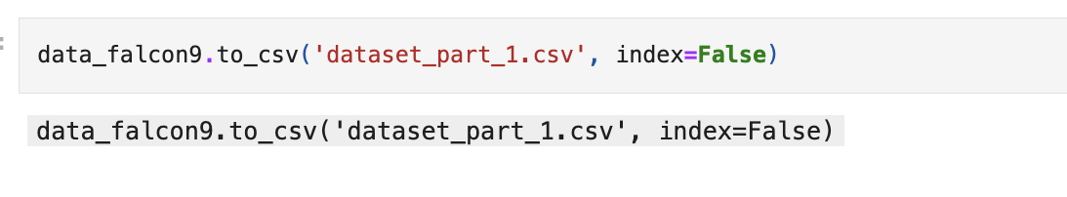
First, we collect the data
Then, we normalize them to a DataFrame using pd.json_normalize
https://github.com/SamedyHUNX/applied-data-science-capstone/blob/main/SPACEX%20-%20DATA%20COLLECTION%20-%20VADHNA%20SAMEDY%20HUN.ipynb

Slide 8
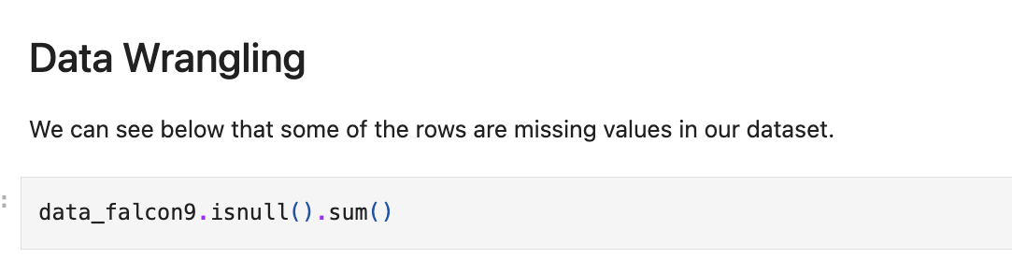
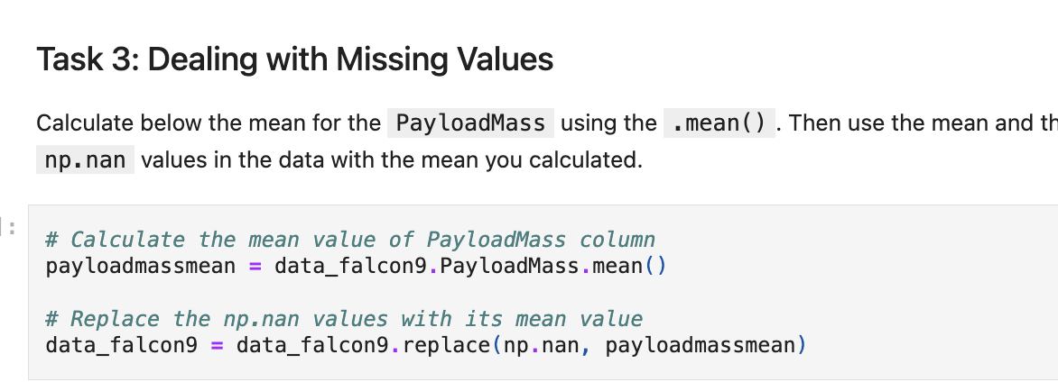
DATA WRANGLING
Data wrangling is one of the most important part in data analysis. In this project, first, we had to check for missing values; then we replaced them with a appropriate method.

Slide 9
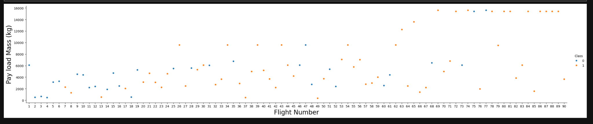
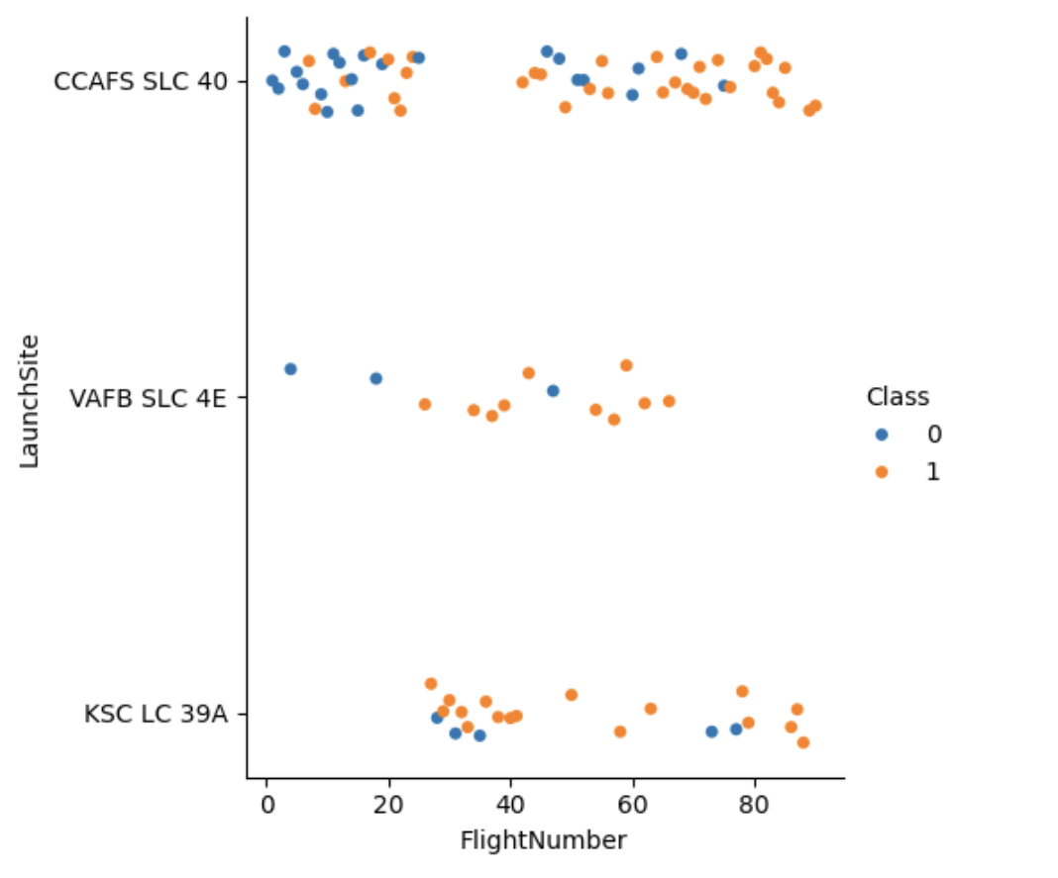
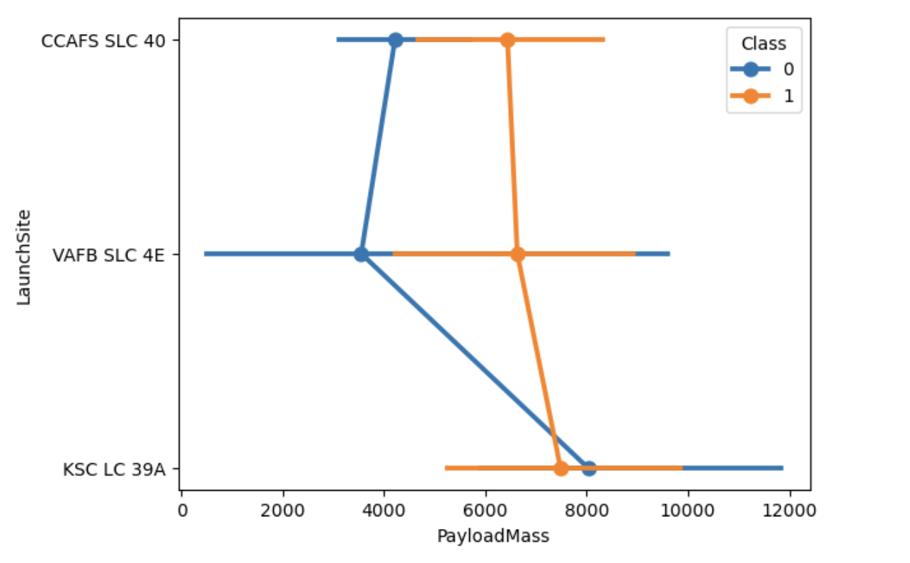
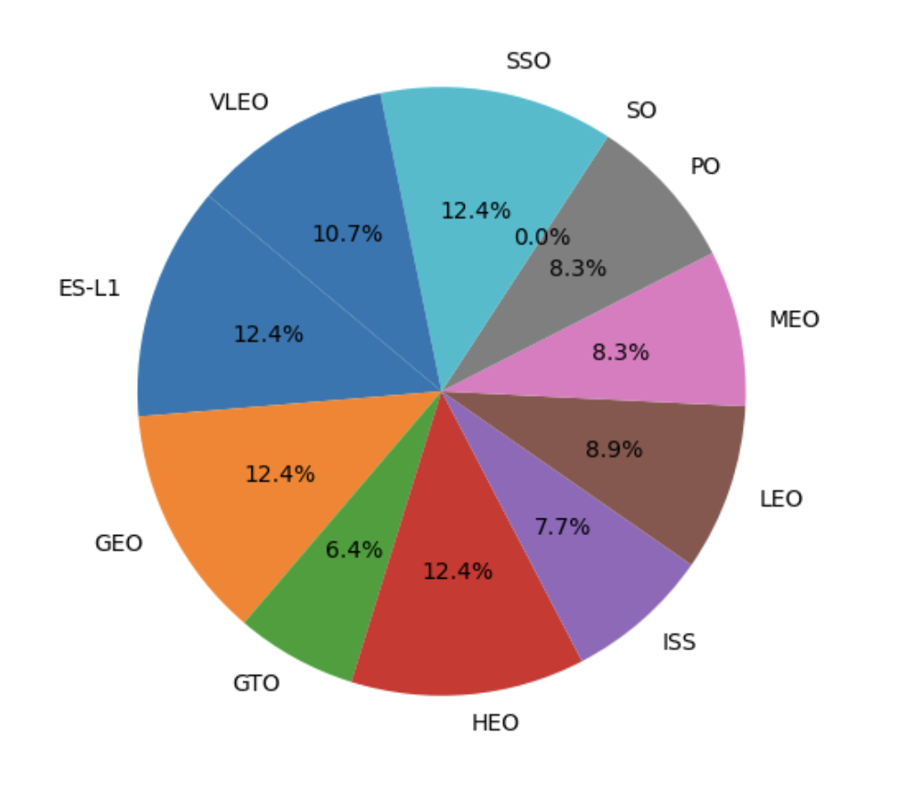
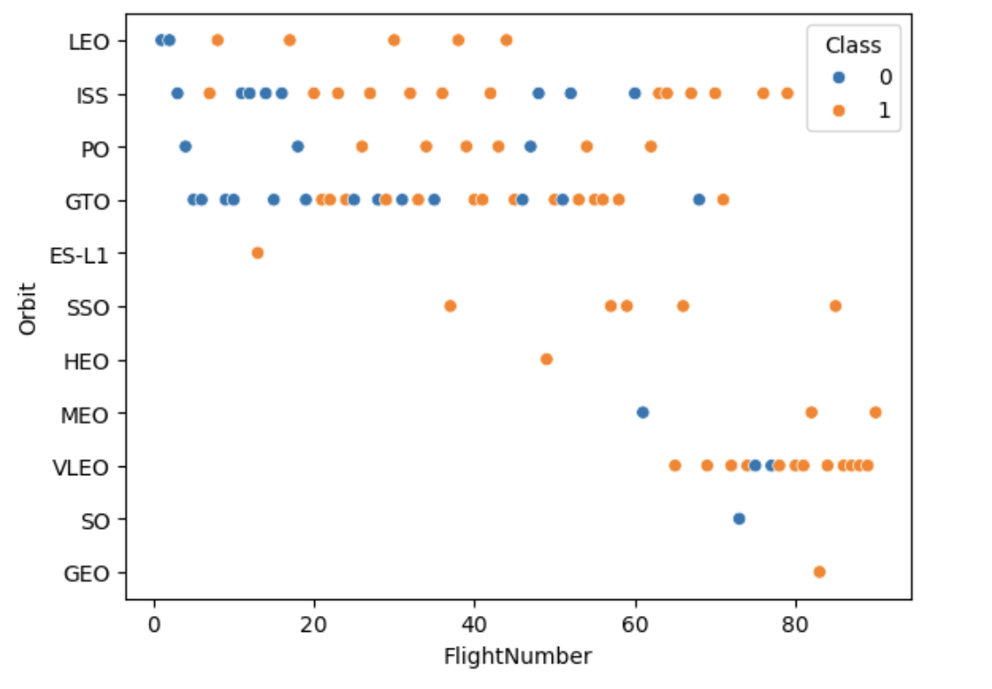
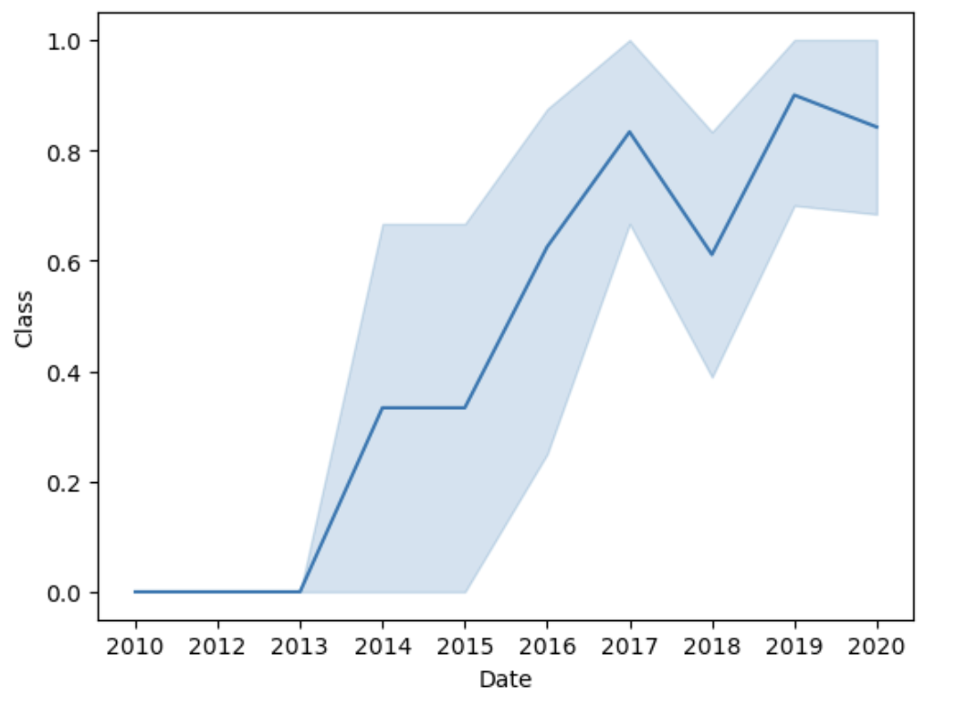
EDA AND VISUALIZATION
https://github.com/SamedyHUNX/applied-data-science-capstone/blob/main/SPCEX%20-%20DATA%20VISUALIZATION%20-%20VADHNA%20SAMEDY%20HUN.ipynb

Slide 10
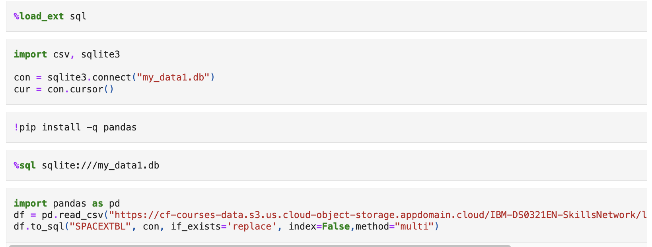
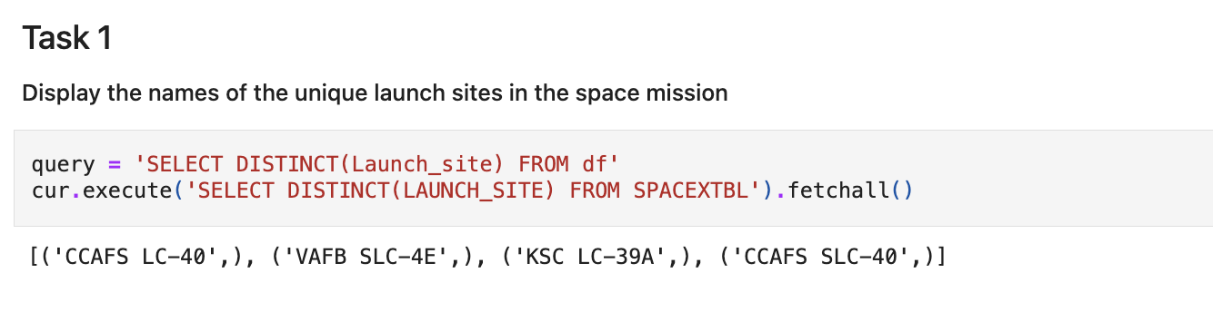
EDA with SQL
SQL gives a better leverage to Python for data query. In this task, instead of using commands in Python to query data, SQL commands were used.
https://github.com/SamedyHUNX/applied-data-science-capstone/blob/main/SPACEX%20-%20CAPSTONE%20-%20SQL%20WITH%20PYTHON%20-%20VADHNA%20SAMEDY%20HUN.ipynb

Slide 11
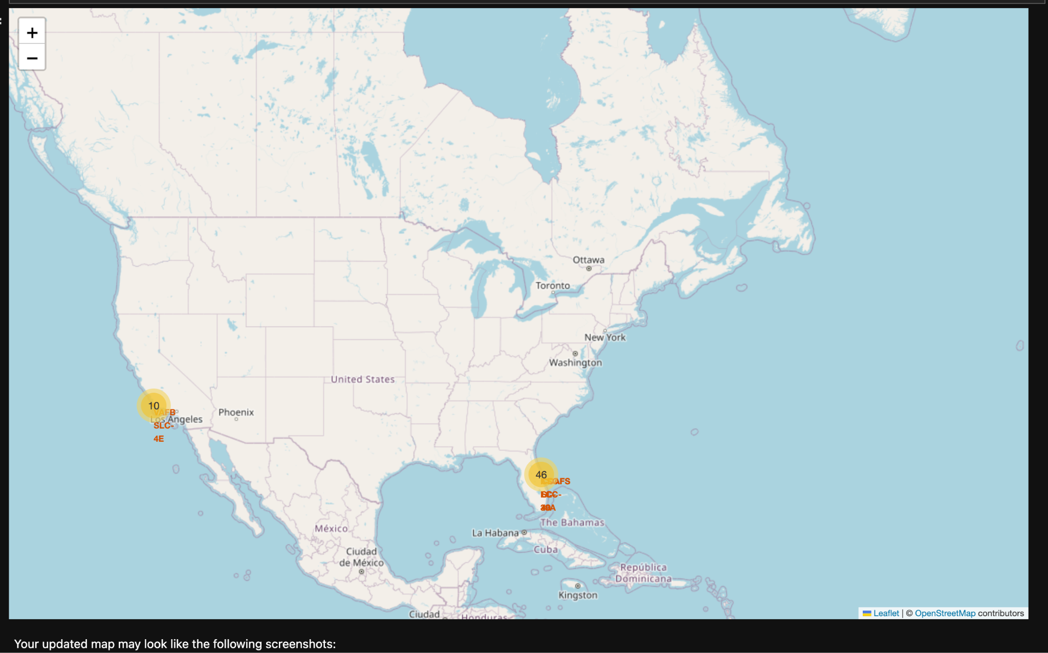
MAP with Folium
https://github.com/SamedyHUNX/applied-data-science-capstone/blob/main/SPACEX%20-%20FOLIUM%20-%20CAPSTONE%20PROJECT%20-%20VADHNA%20SAMEDY%20HUN.ipynb

Slide 12
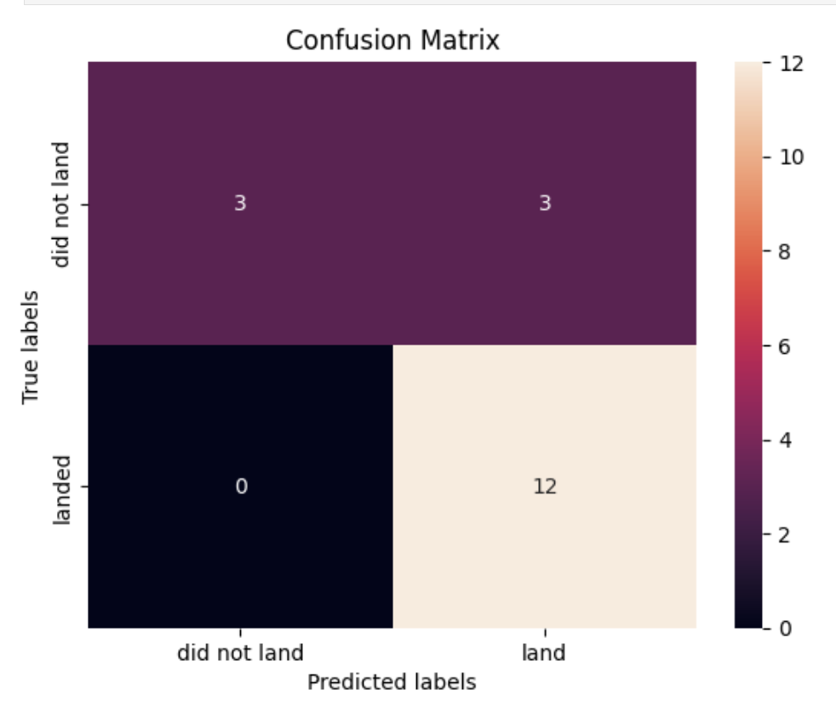
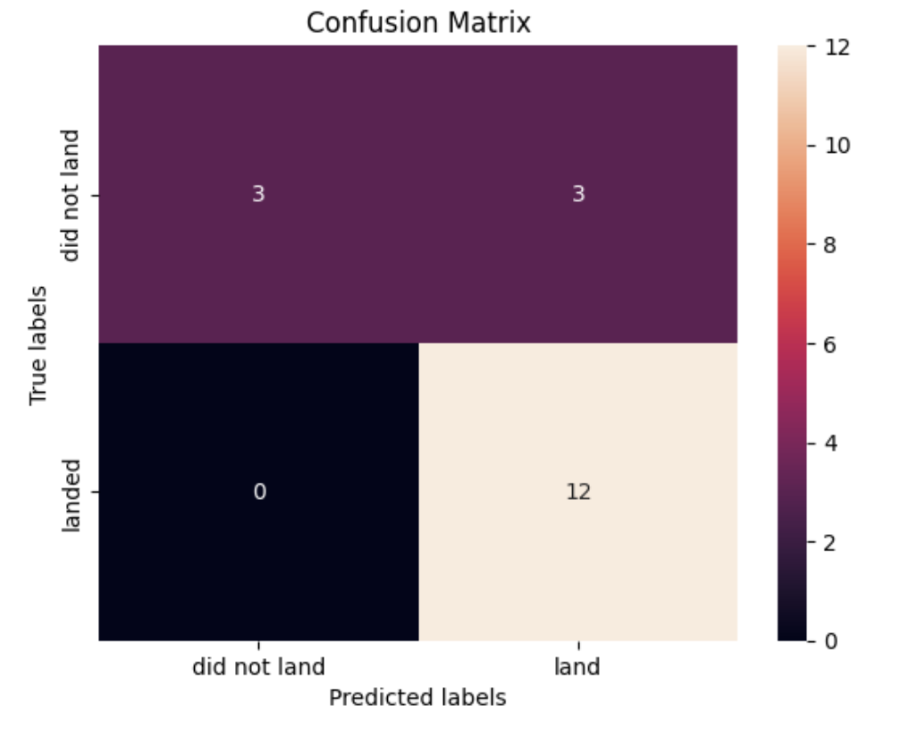
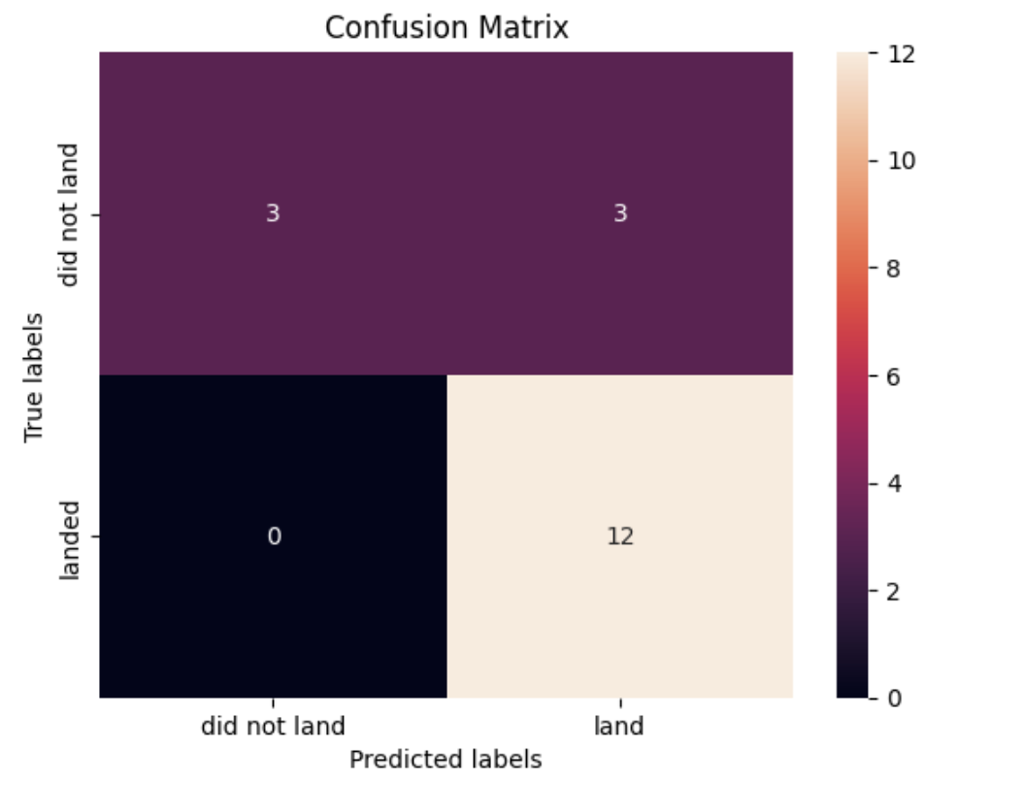
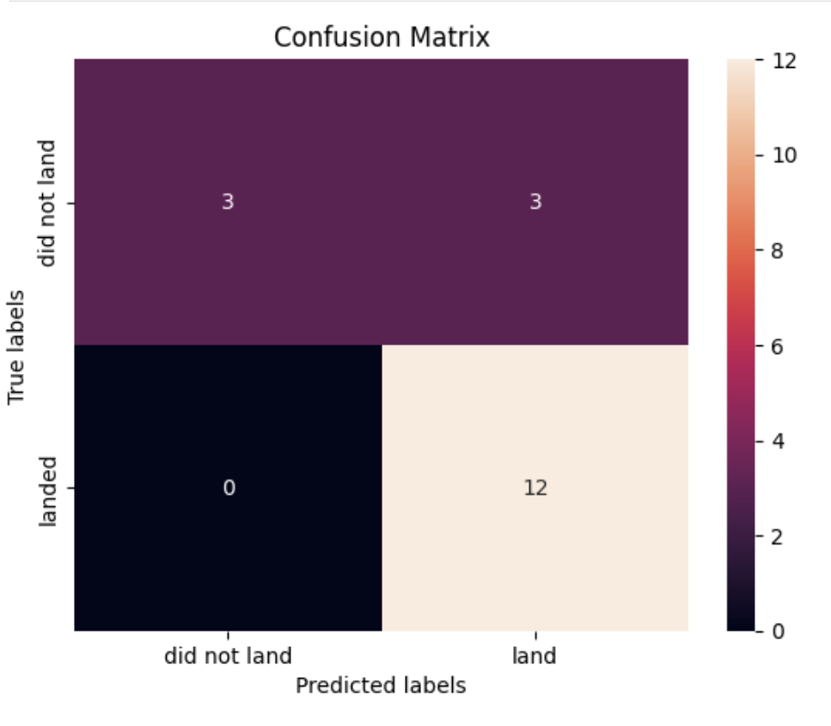
Predictive Analysis (Classification)
SVM, KNN, and Logistic Regression model similarly achieved the highest accuracy score of 83.33%.
https://github.com/SamedyHUNX/applied-data-science-capstone/blob/main/SPACEX%20-%20PREDICTIVE%20ANAYLYSIS%20-%20VADHNA%20SAMEDY%20HUN.ipynb

Slide 13
Results:
KNN is the foremost model for forecasting outcome in this data.
Lighter payloads have a higher performance.
The likelihood of SpaceX launches succeed increases with years.
Launch Complex 39A at Kennedy Space Center has the highest successful launches.
SSO, GEO, ES-L1, HEO orbit types have the highest success rates (all at 12.4%).

Slide 14
II. Insights drawn
Lower payloads mass have a higher succeed rates than higher ones, across all launch sites and models. Flight No. after 78 shows 100% success rates.

Slide 15
Success Rate vs. Orbit Type
SSO, GEO, ES-L1, HEO orbit types have the highest success rates (all at 12.4%).

Slide 16
Flight Number vs. Orbit Type
Launches numbers and success rates are slowly shifted to VLEO orbit in the later years. (Circled)

Slide 17
Payload mass vs. Launch sites
Optimal masses of a payload is between 6000 and 8500 kg.

Slide 18
Launch Success Yearly Trend
Launch Success trend is increasing sharply upwards since 2013. This is possibly due to advancement of technology and experience.

Slide 19
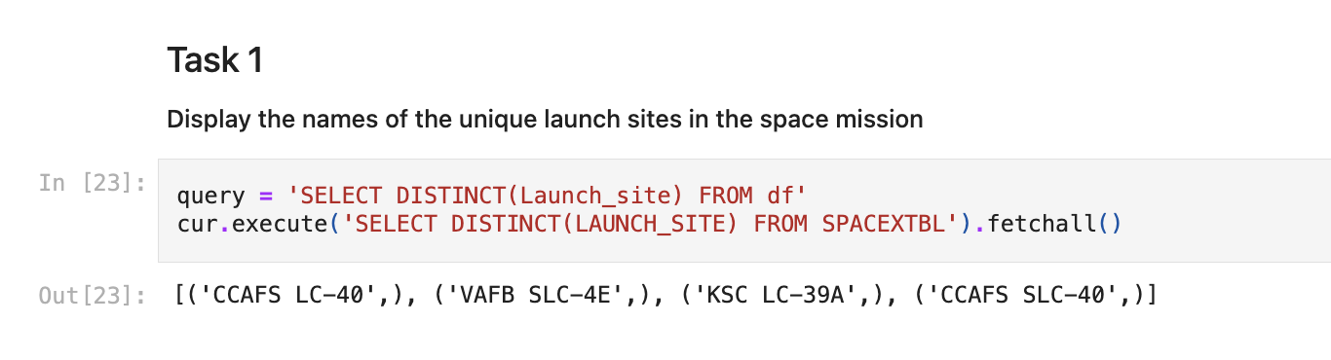
All Launch Site Names
Display all launch sites using SQL commands: there are 4 unique launc sites.

Slide 20
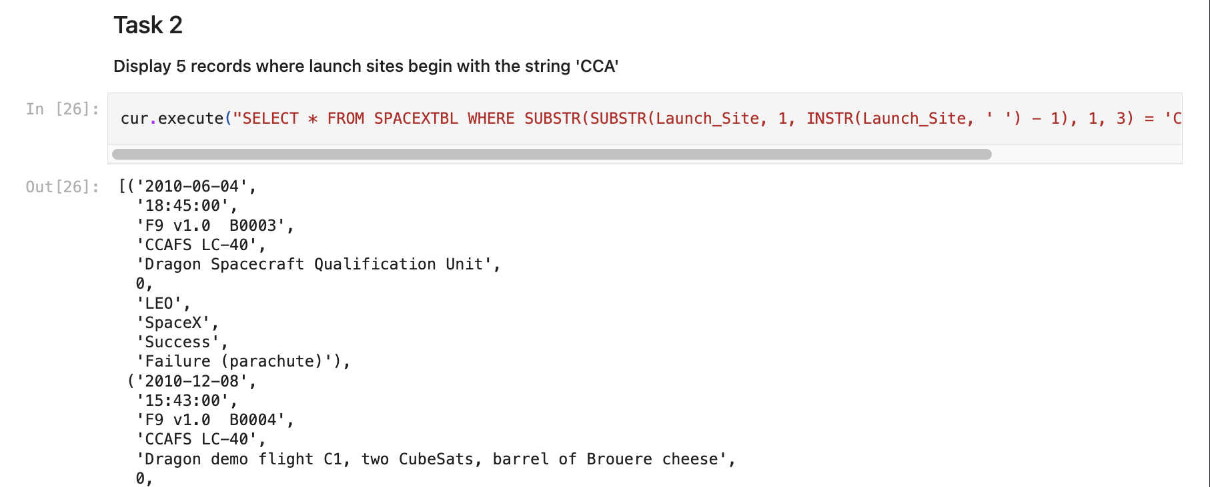
Launch Site Names Begin with ‘CCA’

Slide 21
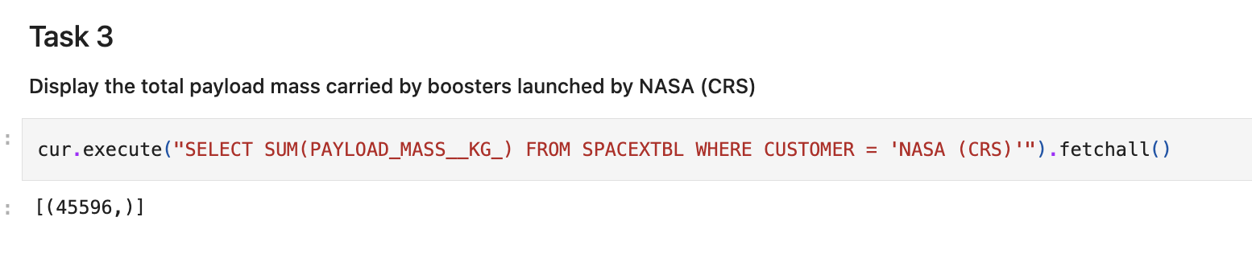
Total Payload Mass

Slide 22
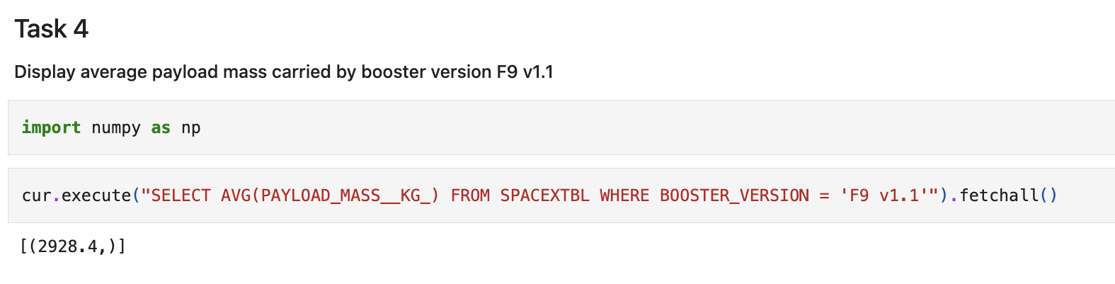
Average Payload Masss by F9 v1.1

Slide 23
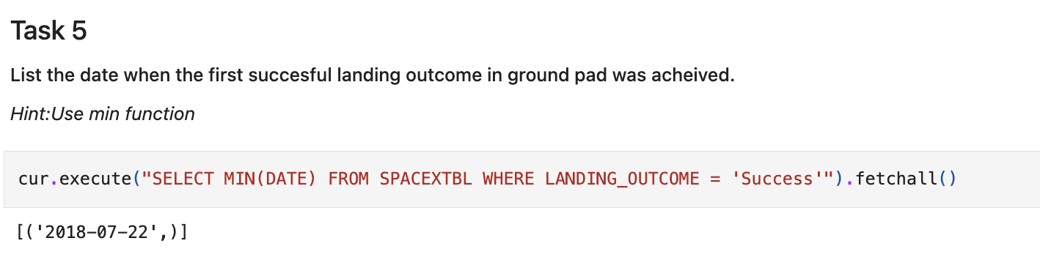
First Successful Ground Landing Date

Slide 24
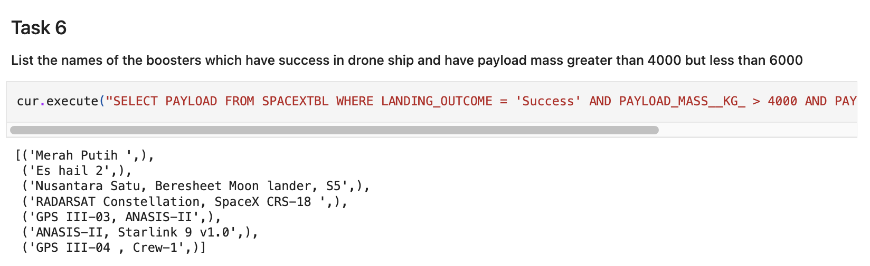
Successful Drone Ship Landing with the Payload between 4000 and 6000

Slide 25
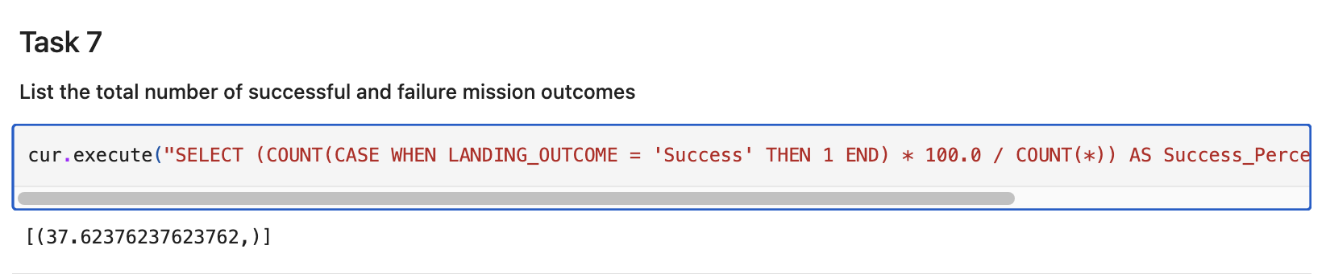
Success Rate (%)

Slide 26
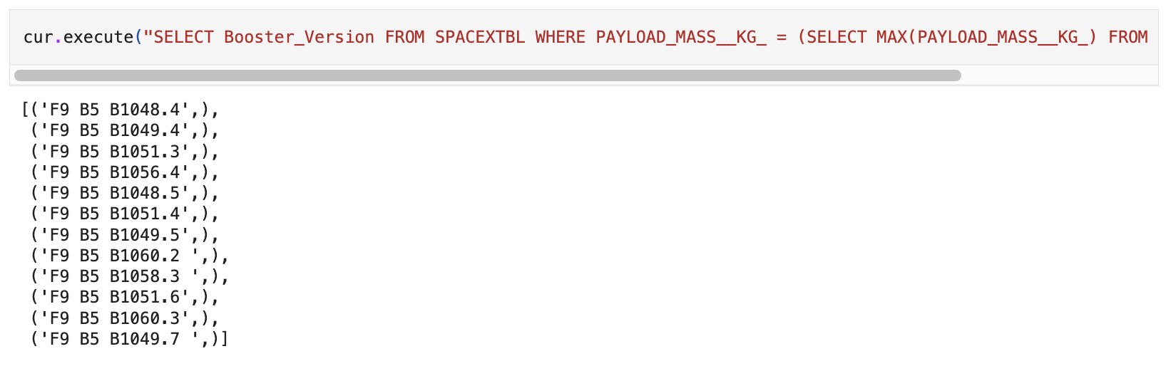
Boosters Carried Maximum Payload Mass

Slide 27
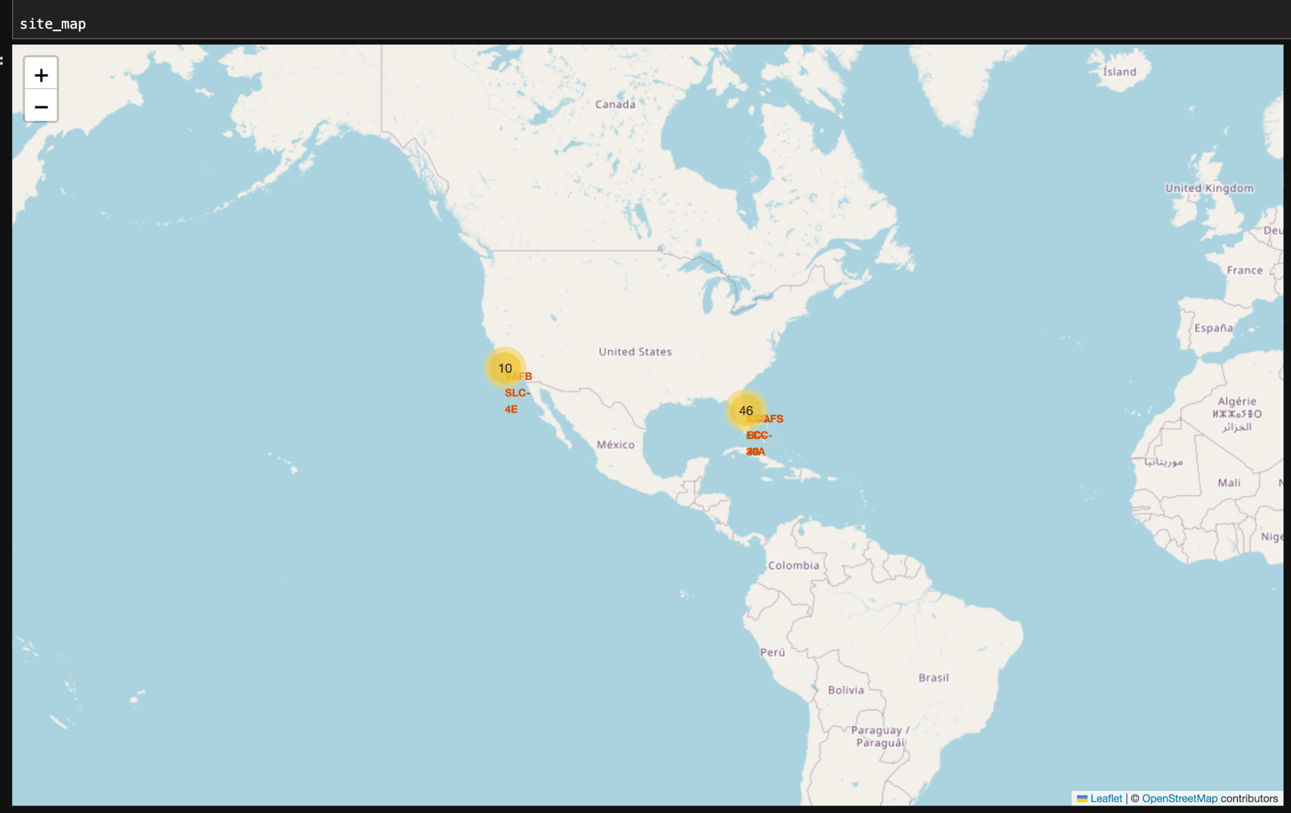
III. Launch Sites Approximity Analysis

Slide 28
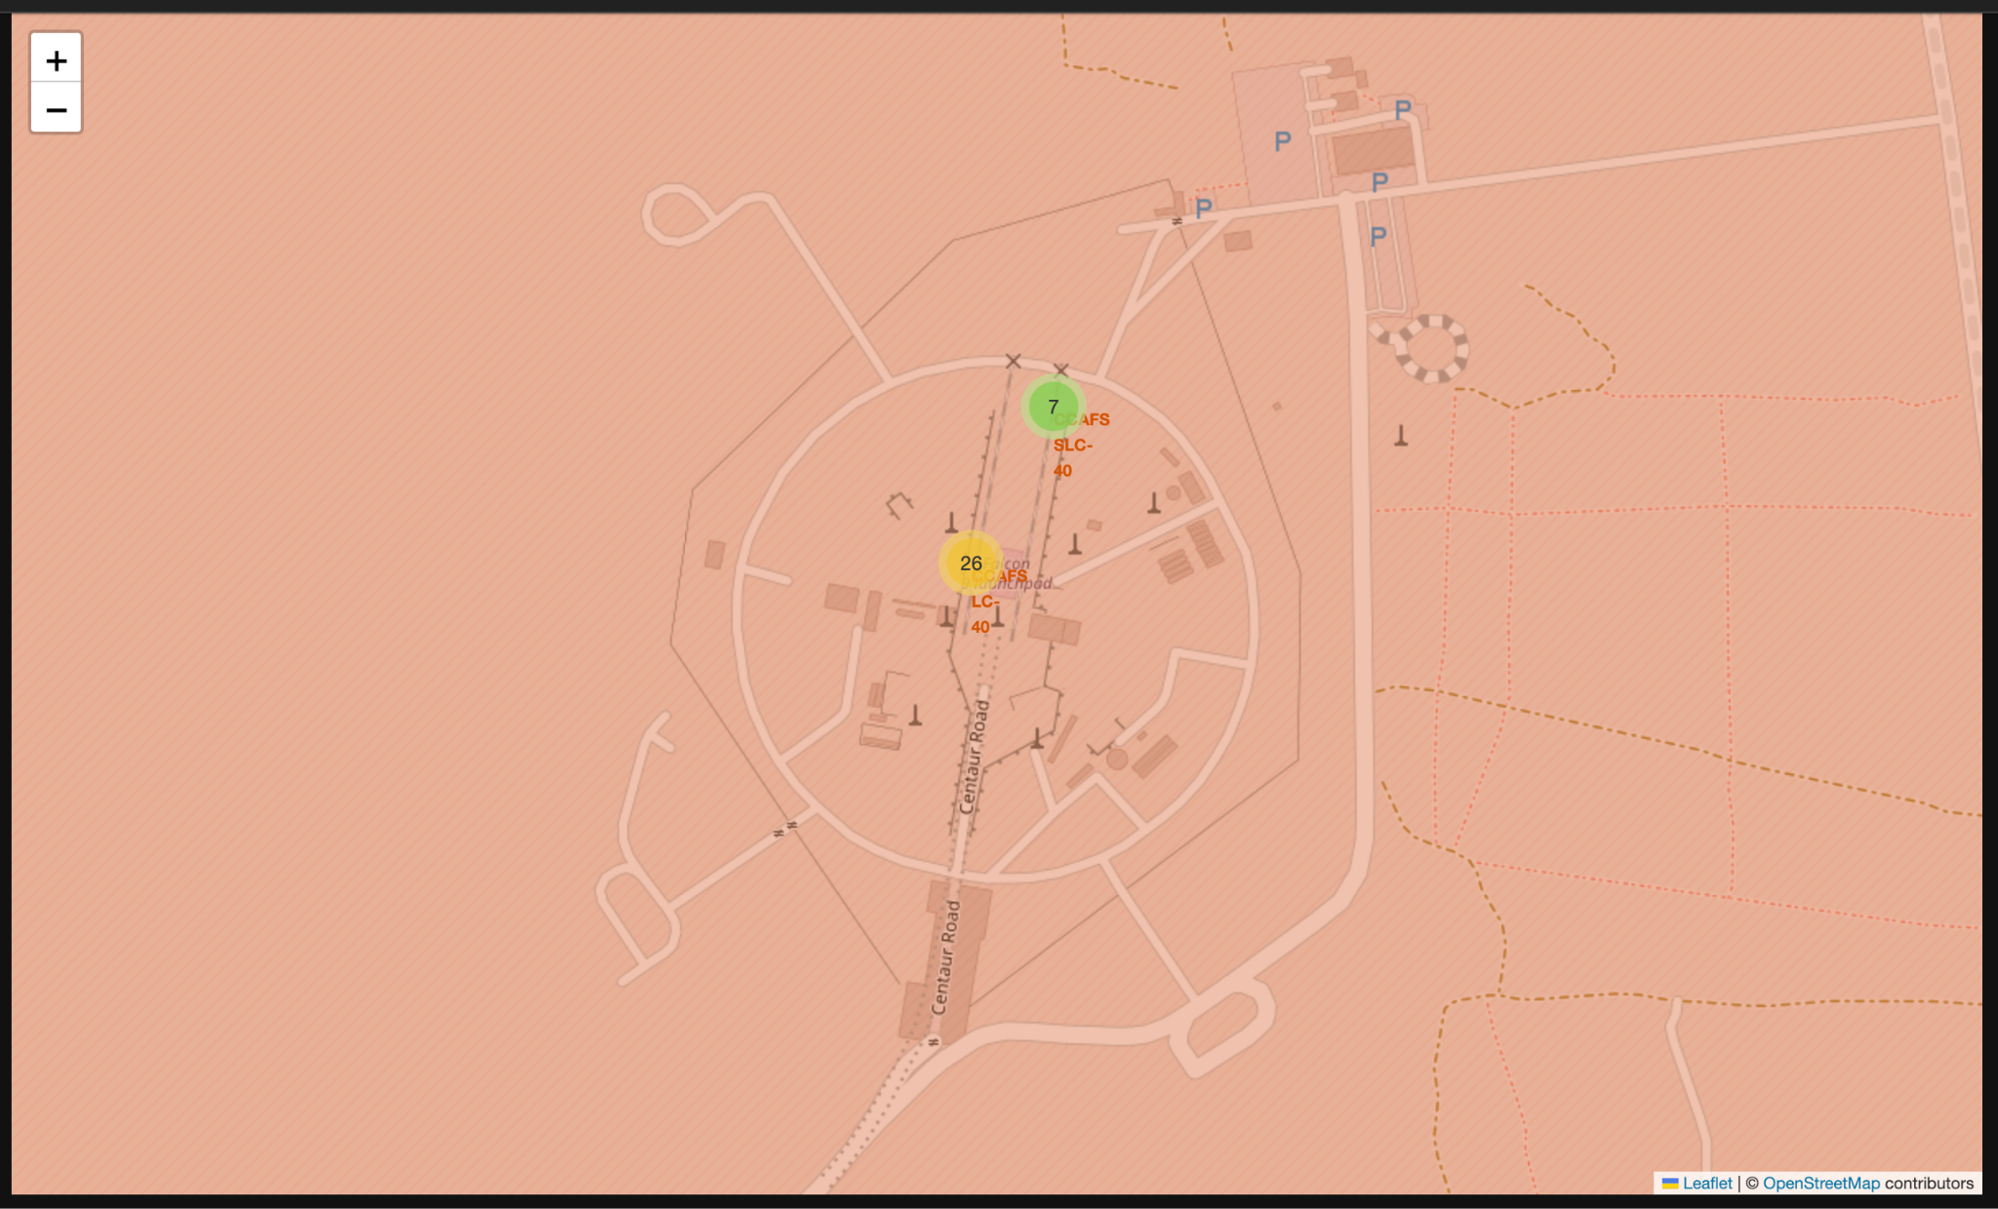
Success/failed launches for each site

Slide 29
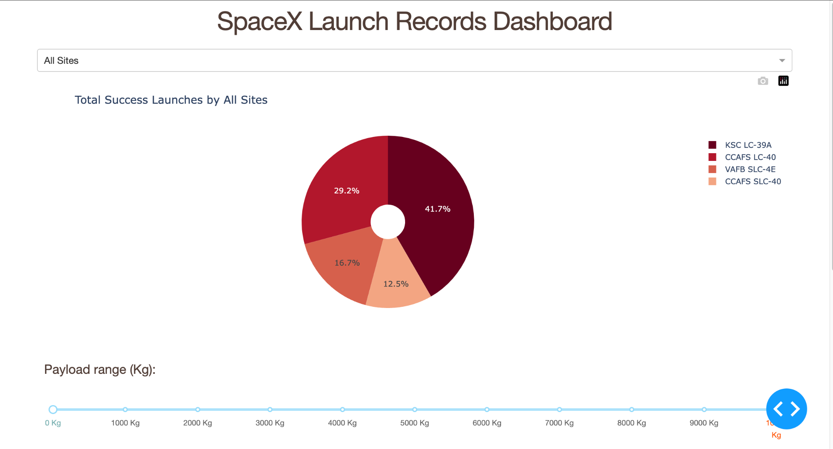
IV. Build a Dashboard with Plotly

Slide 30
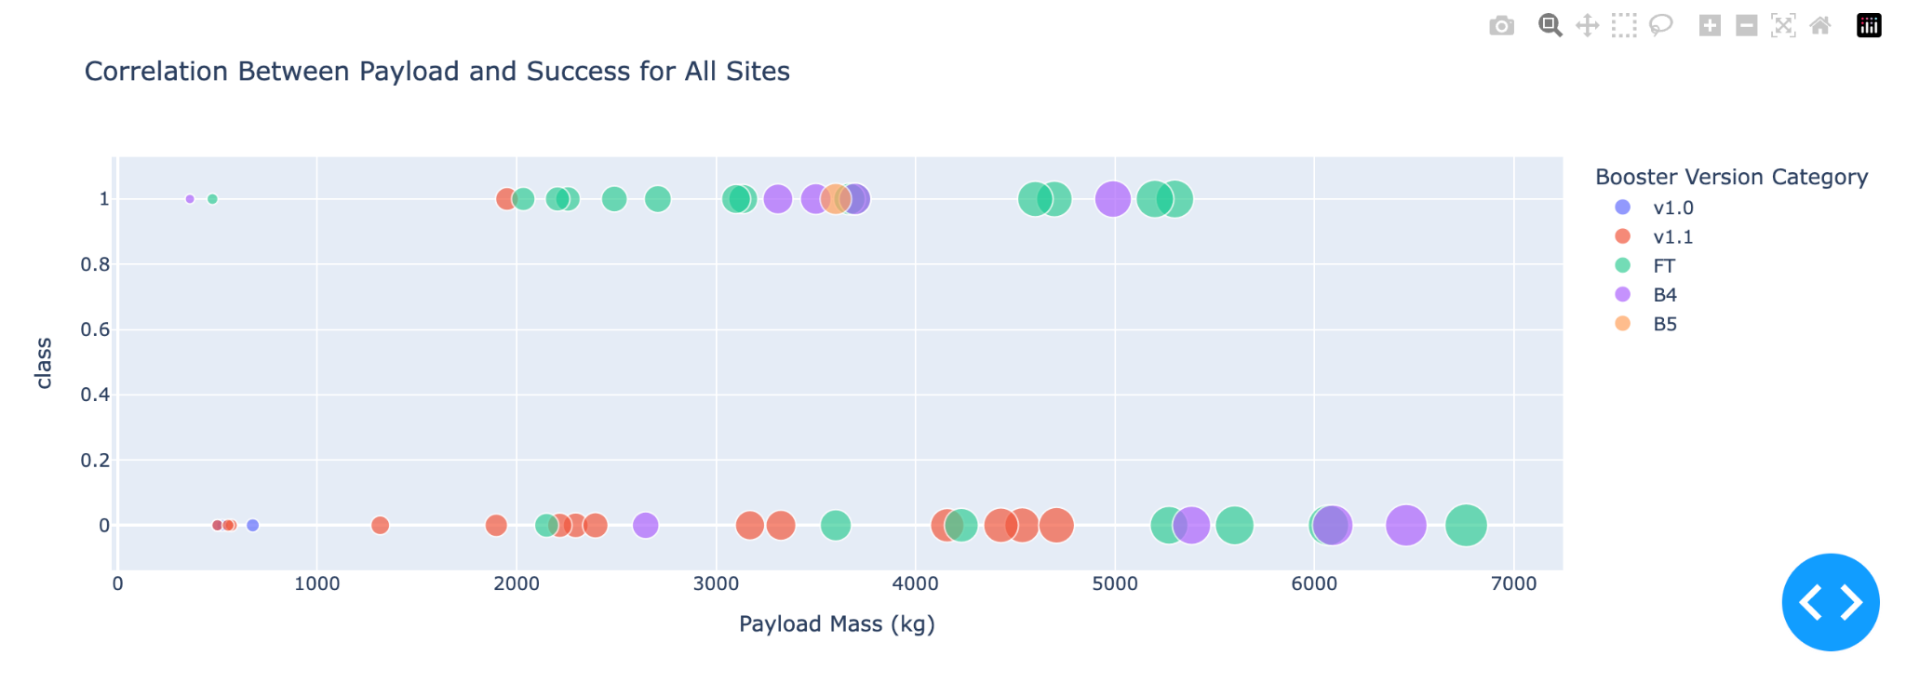
Payload vs. Launch outcome
Highest success rates occur when the payload is between 2000 and 4000kg.
Booster FT (green) has the highest success rate.

Slide 31
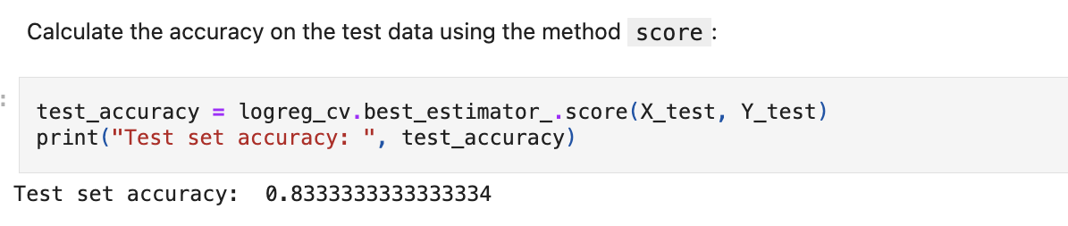
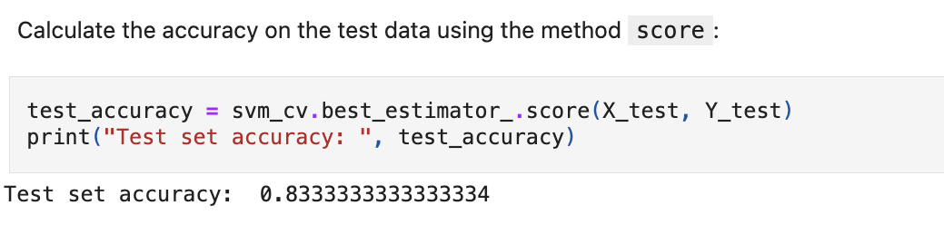
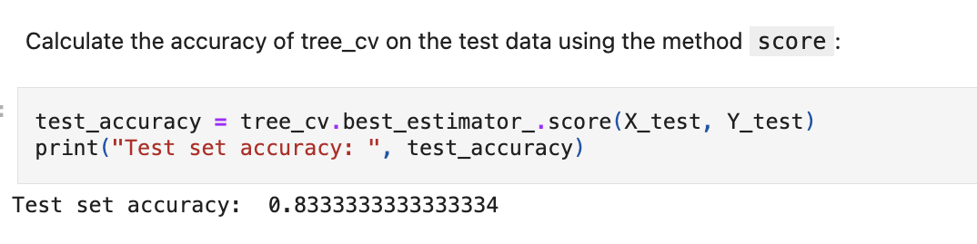
V. Predictive Analysis (Classification)

Slide 32
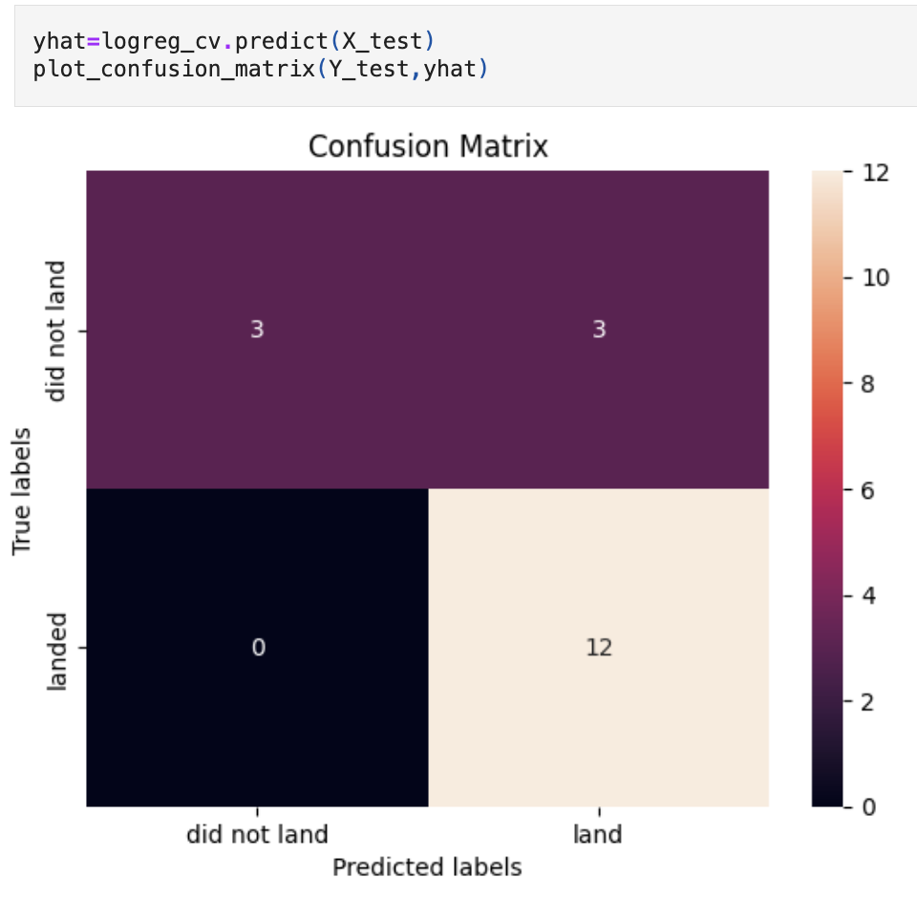
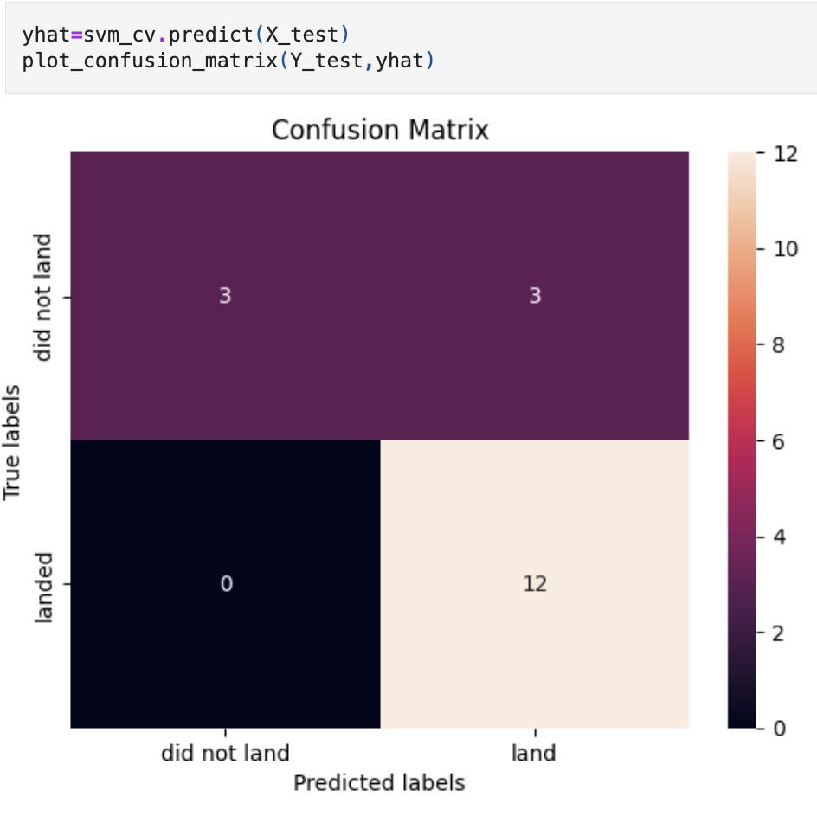
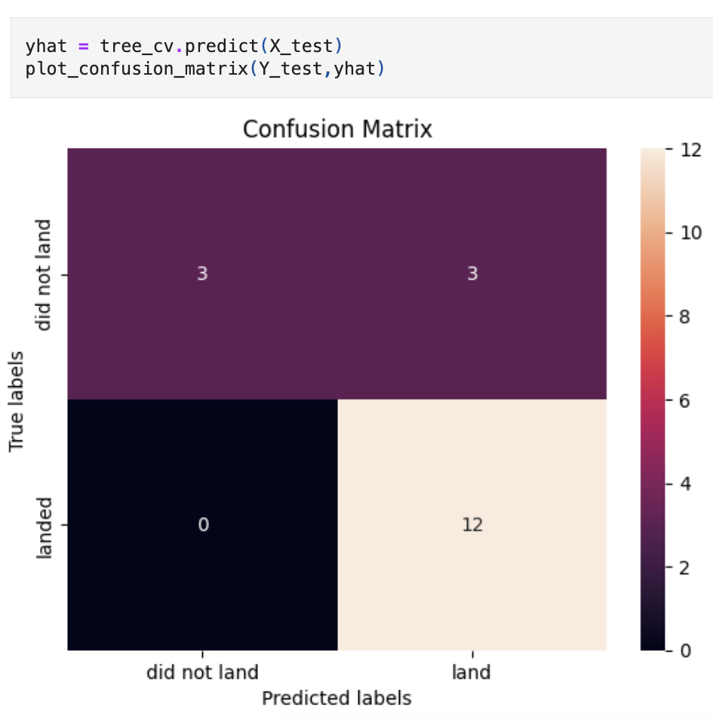
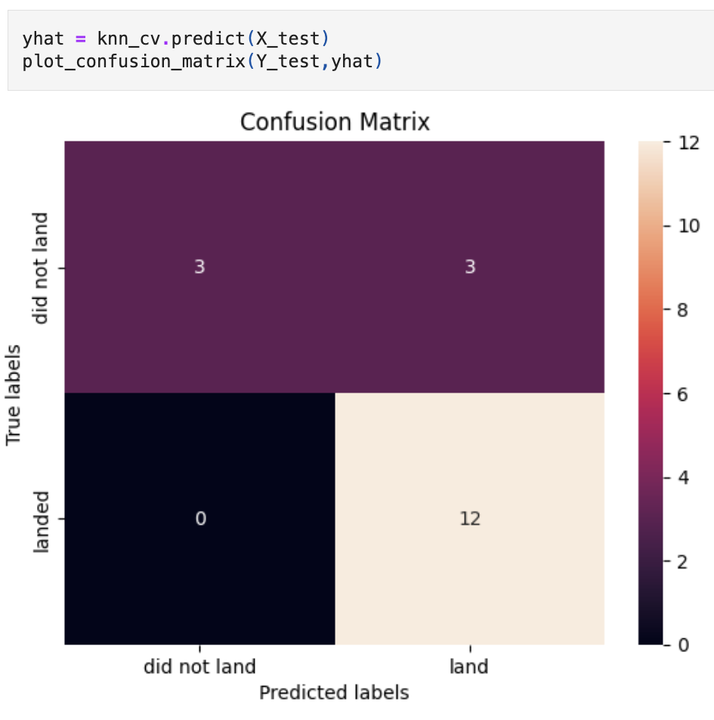
Confusion Matrix
LR, SVM, KNN are good as their confusion matrix show predicted 12 successful landing correctly.
They have the same accuracy off 83.33%.

Slide 33
Conclusions:
LR, SVM, KNN can be used as model for forecasting (SpaceX).
Lighter payloads have a higher success than heavier ones. But optimality between 2000 and 4000 should be opted for.
The likelihood of success increases in respect with time, but can be certain that there will be increase of success rates in upcoming years.
GEO, HEO, SSO, ES L1 orbit types exhibit the highest rates.
Launch Complex 39A has the highest numbers of success launches.

